Slide 1
Chapter 8
Irrational Roots
Clark/Anfinson

Slide 2
Chapter 8 – section 1
Root functions

Slide 3
Investigating a function
f(x) = $\sqrt{x+2}$ is a function g(x) = $\sqrt[3]{x−5}$ is also a function
Standard questions -
domain
range
increasing/ decreasing
solution points
y – intercept, x – intercept
BY HAND you make a table and look for patterns
Find f(-5) f(-1) f(1) f(2) f(3) f(6) …. g(-3) g(0) g(2) g(46) g(52)
Calculator makes table and we look for patterns.

Slide 4
Graph

Slide 5
What the graphs tell us
Even roots
Odd root
domain is restricted
Range is restricted
generally increasing
Negatives cause decreasing behavior
Not a constant rate of increase or decrease
Domain is not restricted
Range is not restricted
generally increasing
Negatives cause decreasing behavior
Not a constant rate of increase or decrease

Slide 6

Finding domain and range
$g\left(x\right)= \sqrt{x −9}$
$k\left(x\right)=−2\sqrt{3−x}$
$m\left(x\right)=3 \sqrt[3]{2x−7}$
$n\left(x\right)= \sqrt[4]{2x−5}$

Slide 7
Domain and range continued
$t\left(x\right)= \sqrt[3]{2x−5}$ If the domain of t(x) is restricted to [ -2, 32] what is the range of t(x)

Slide 8
Answering f(x) questions using graph
Use the graph to find f(4) , f(6) and f(-3)
Use the graph to find where f(x) = 2, f(x) = 3.5

Slide 9
Chapter 8 - section 2
Simplify/add-subtract irrational roots

Slide 10
Irrational numbers
Operating with a root on a number that is not of that power produces an irrational number
ex: $\sqrt{16}=4$
$\sqrt{10}$ or $\sqrt[3]{4}$ are irrational
While estimating them is good enough for graphing analysis and for many practical applications there are times when an exact answer is necessary - like fractions we must learn to operate with the radical sign present

Slide 11
Simplifying radicals
A radical is considered simplified when there are no factors within the radical that are higher powers than the root.
ie. If the root is 2 there are NO powers inside the radical
if the root is 3 there are no square powers inside the radical

Slide 12
To simplify a root: separate it into factors looking for powers –
Ex $\sqrt{8}=$ $\sqrt{12}=$ $\sqrt[3]{16}=$
$\sqrt[3]{54m^{4}n^{2}}=$ $\sqrt{9x^{5}y^{8}}$ =

Slide 13
Addition and radicals
$\sqrt{x^{2}−4}$ cannot be simplified
$\sqrt{{\left(x −2\right)}^{2}}$ can be simplified
$\sqrt{5}+\sqrt{10}$ cannot be simplified
$\sqrt{5}+\sqrt{5}$ can be simplified
addition of radicals is like addition with variables - Using distribution(factoring) you separate the radical from the coefficient and add the coefficients

Slide 14

Examples
$4\sqrt{3}+8\sqrt{3}$ =
$6\sqrt[3]{5x}−8\sqrt[3]{5x}$ =
$\sqrt{5}+7\sqrt{3}+9\sqrt{5}=$
$5\sqrt[3]{2 } −7\sqrt{2}+4\sqrt[3]{2}$=

Slide 15

Simplify radicals BEFORE you add
$3\sqrt{8}+2\sqrt{18}$ =
$−6\sqrt[3]{54m^{4}}+2m\sqrt[3]{16m}+5\sqrt{8m^{5}}$

Slide 16
Chapter 8 – section 3
Multiplying/dividing radicals

Slide 17
2 variations on rule
$\sqrt[b]{x}∙\sqrt[b]{y}=\sqrt[b]{xy}$ - if the exponents match you can regroup under one radical
$\sqrt[b]{x^{a}}∙\sqrt[c]{x^{d}}=x^{a/b}∙x^{c/d}$ if the exponents don’t match but the bases do switch to exponent notation and add the exponents

Slide 18

Examples
$\sqrt{3}∙ \sqrt{5}$=
$2\sqrt{10}∙3\sqrt{2}$ =
$\sqrt{5}∙ \sqrt{5}$=
$\sqrt[3]{10}∙\sqrt[3]{6}$ =
$\sqrt[3]{18}∙\sqrt[3]{6}=$

Slide 19

Multiplication with addition
$\left(3−\sqrt{2}\right)\left(5+2\sqrt{7}\right)$
$\left(4+2\sqrt{5}\right)\left(3+7\sqrt{5}\right)$
$\left(5+\sqrt{7}\right)\left(5−\sqrt{7}\right)$

Slide 20

Division with radicals
Do NOT leave any radicals in denominator –
$\frac{\sqrt{28}}{\sqrt{7}} =$
$\frac{\sqrt{5}}{\sqrt{3}}$ =
$\frac{3+\sqrt{7}}{\sqrt{2}} =$
$\frac{2+\sqrt{3}}{5−\sqrt{2}}$ =
$\frac{\sqrt[3]{2}}{\sqrt[3]{3}}$
$\frac{5\sqrt[3]{6}}{\sqrt[3]{25}}$
$\frac{\sqrt[3]{5}}{\sqrt[3]{12}}$

Slide 21
Chapter 8 – section 4
Solving radical equations

Slide 22
Solving – isolate the variable by inversing
You can do ANYTHING to an equation as long as you change both SIDES the same way.
Anything includes inserting and exponent on the WHOLE side

Slide 23

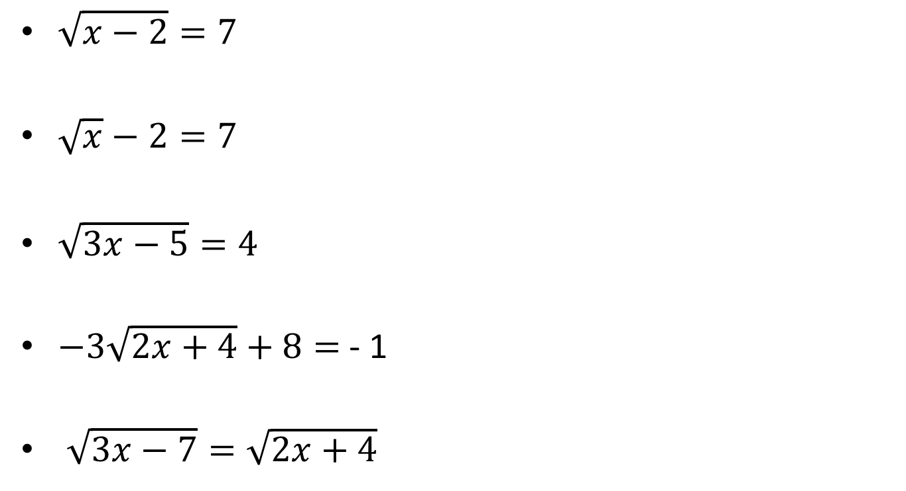
Example
$\sqrt{x−2}=7$
$\sqrt{x}−2=7$
$\sqrt{3x−5}=4$
$−3\sqrt{2x+4}+8=$- 1
$\sqrt{3x−7}=\sqrt{2x+4}$
$\sqrt[3]{x}$= 5
$\sqrt[3]{2x−8}$ = 3
$\sqrt{x^{2}−2}=3 −x$

Slide 24

How restrictions affect solving
$\sqrt{x}+9=2$
$\sqrt{x^{2}−2}=x −3$

Slide 25
Chapter 8 – Section 5
Imaginary numbers

Slide 26
Definition
$\sqrt{−1}$ is undefined in the domain of real numbers - This leads to the question – What if there was a number (let’s call it $i$ ) such that $i^{2}=−1$ This is not a real number so we have “invented” a whole set of numbers – we call them imaginary numbers and since they are useful we continue to study them
When you add a real number to an imaginary number you have a complex number

Slide 27

Examples
$\sqrt{−4}=$ $\sqrt{−9}=$ $\sqrt{−12}=$
NOTE $\sqrt[3]{−8}$ is NOT imaginary
$5+\sqrt{−16}$ =

Slide 28
Simplifying Complex numbers
$i$ works like a variable EXCEPT that when you square, it becomes a -1
Examples:
(3 + 2i) + (5 – 6i)
(4 + 2i) – (9 + 5i)
(3i)(7i)
(4 – 2i)(6 + 5i)
$\frac{3−2i}{5}=$ $\frac{7 −6i}{2i}$=

